Slide 1
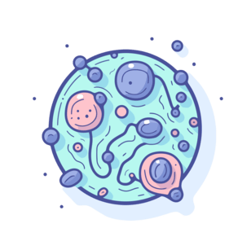
Automated Detection of Malaria-Infected Cells from Microscopic Images using Deep Learning
Chow Chun Kei (33520771), Wesley Kong Zhe Hung (33521743), Esher Loh Ci Ying (34392793), Lim Hui Shawn (34017259), Gue Zhen Xue (33521352)

Slide 2
Table of Contents
1
Introduction
2
Data Loading
3
Exploratory Data Analysis (EDA)
4
Modelling
5
Results
6
Conclusions

Slide 3
Introduction
1
Background, Problem Statement, Research Objective

Slide 4

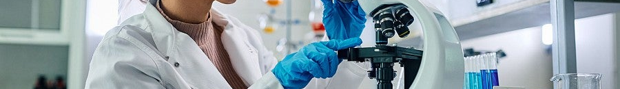
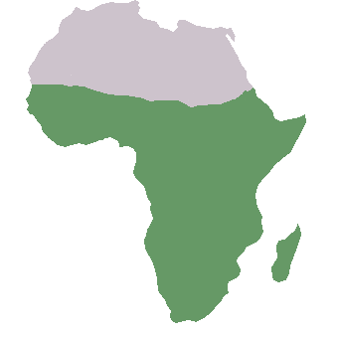
Introduction
Background
Parasitic Disease
Life-threatening Disease
What is Malaria?
infecting red blood cells
could be transmitted by Anopheles mosquitoes
if it is untreated
severe anemia & acute organ failure
sub-Saharan Africa
was home to 94% of malaria cases (~246 million) & 95% (~569,000) of malaria deaths
according to World Health Organization (WHO) Malaria Report 2024

Slide 5
Introduction
Problem Statement
1
Complex Conventional Method
2
Limited Resources
Malaria is detected through blood smear microscopy:
These resources are very limited in sub-Saharan Africa, the region with the world's highest malaria burden
Resulting in diagnostic delays and consequently preventable deaths
Time consuming
Requires skilled microscopists
Research Questions
“
Can we develop an automated deep learning system to detect malaria-infected cells
without requiring expert microscopists ?

Slide 6
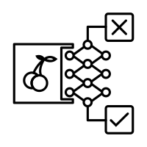


Introduction
Problem Objectives
Using a malaria cell images dataset originally sourced from the National Institutes of Health (NIH),
Develop a High-Accuracy Binary Classifier
Optimize Diagnostic Performance
Train deep learning model to distinguish between parasitized vs. uninfected cells
Maximize recall for infected cells &
Achieve strong AUC-ROC metrics to ensure both cell classes are identified accurately

Slide 7
Data Loading
2
Dataset Overview, Set Splits, Image preprocessing & Data augmentation

Slide 8
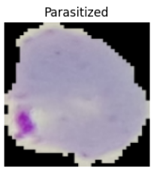
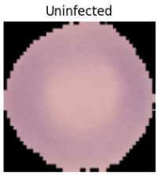
Data Loading
Dataset overview - Image dataset
🗁 Parasitized
Total images: 13779
🗁 cell_images
Total images: 27558
🗁 Uninfected
Total images: 13779

Slide 9
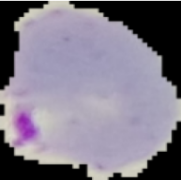
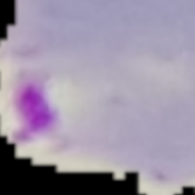
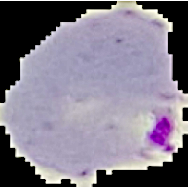

Data Loading.
Image preprocessing
Resized and center-cropped to 224x224 pixels
Original pixel value range [0,255] → Normalized to [-1,1]
Preprocessed parasitized cell image
Data augmentation
Zoomed in up to 20% closer up
(randomly)
Flipped horizontally
(~50% of the time)
Sharpened by factor 2.0
(~30% of the time)
Rotated by ±10°
(randomly)

Slide 10
Exploratory Data Analysis (EDA)
3
Class Distribution Analysis, Pixel Intensity Value Analysis, Principal Component Analysis (PCA)

Slide 11
Exploratory Data Analysis (EDA)
Overall Approach
1
Class Distribution Analysis
2
Pixel Intensity Distribution Analysis
3
Principal Component Analysis (PCA)

Slide 12
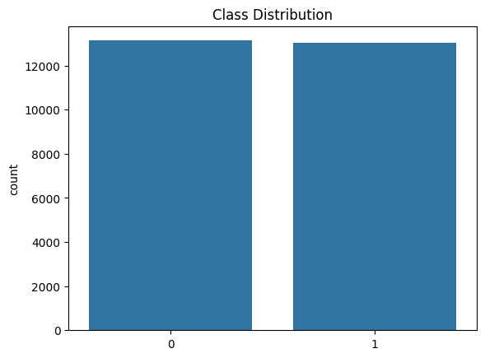
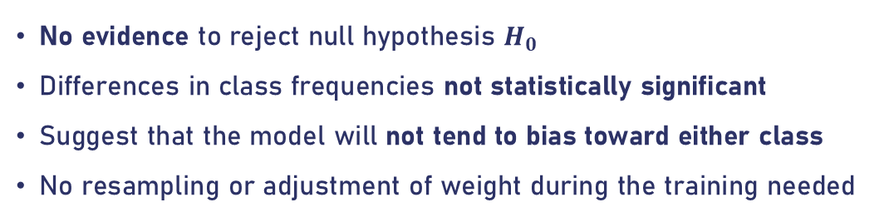
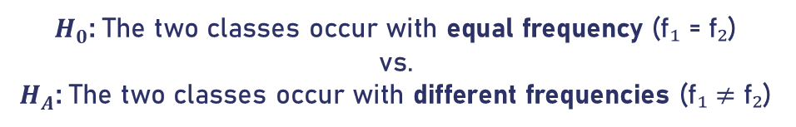
Exploratory Data Analysis (EDA)
1
Class Distribution Analysis
To assess the class balance of the dataset
Chi-Squared Test
$H_{0}$: The two classes occur with equal frequency (f₁ = f₂)
vs.
$H_{A}$: The two classes occur with different frequencies (f₁ ≠ f₂)
Observation
Significance level of 0.05.
No evidence to reject null hypothesis $H_{0}$
Differences in class frequencies not statistically significant
Suggest that the model will not tend to bias toward either class
No resampling or adjustment of weight during the training needed
p-value = 1.0

Slide 13
Exploratory Data Analysis (EDA)
2
Pixel Intensity Distribution Analysis
Two Sample t-test
To compare the means of 2 independent groups, assuming the underlying distributions are normal
$H_{0}$: Mean pixel intensities of uninfected cells = parasitized cells (no difference)
vs.
$H_{A}$: Mean pixel intensities of uninfected cells $≠$ parasitized cells (there is a difference)
Kullback–Leibler (KL) Divergence
Quantify the degree of dissimilarity between the two pixel intensity distributions
measured how much information is lost when one probability distribution is used to approximate another

Slide 14
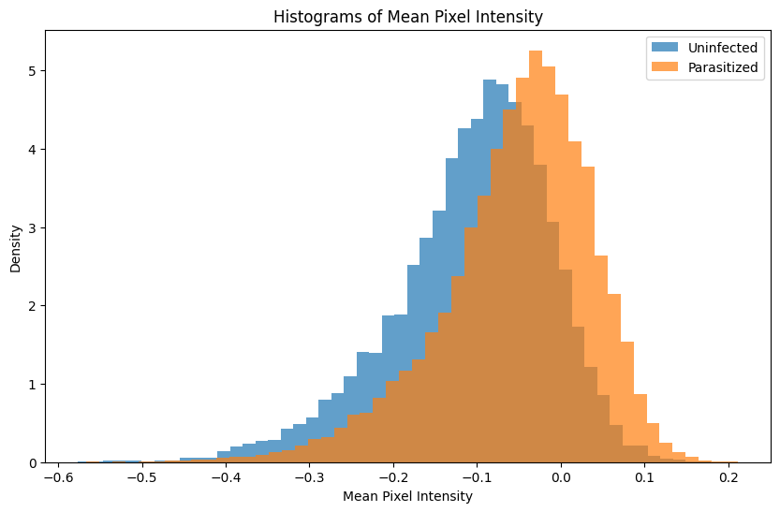
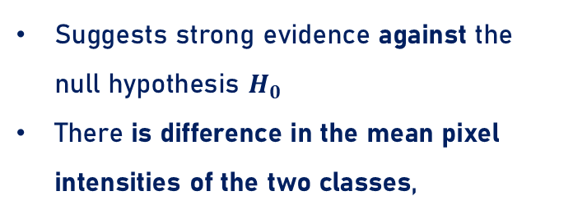
Exploratory Data Analysis (EDA)
2
Pixel Intensity Distribution Analysis
Two Sample t-test
Significance level of 0.05.
Suggests strong evidence against the null hypothesis $H_{0}$
There is difference in the mean pixel intensities of the two classes,
p-value = 0.0
Kullback–Leibler (KL) Divergence
Suggests both distribution share a similar overall shape
Exist only subtle difference in pixel intensity patterns
Difficult to distinguish between each classes in modelling
KL-Divergence = 0.0594

Slide 15
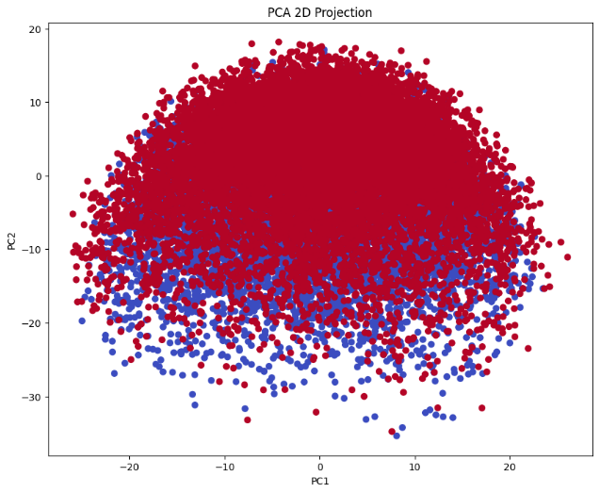
Exploratory Data Analysis (EDA)
3
Principal Component Analysis (PCA)
Projection to 2D Space
PCA shows projection of the data in 2-dimensional space
There is a high degree of overlap between 2 classes
Suggests subtle difference in pixel-level features
Machine Learning or Deep Learning?
Not linearly separable in low-dimensional space
Simple linear models may struggle
Non-linear or deep learning approaches required

Slide 16
Modelling
4
Baseline CNN, Transfer Learning

Slide 17


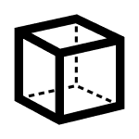
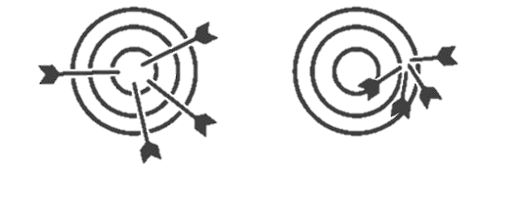


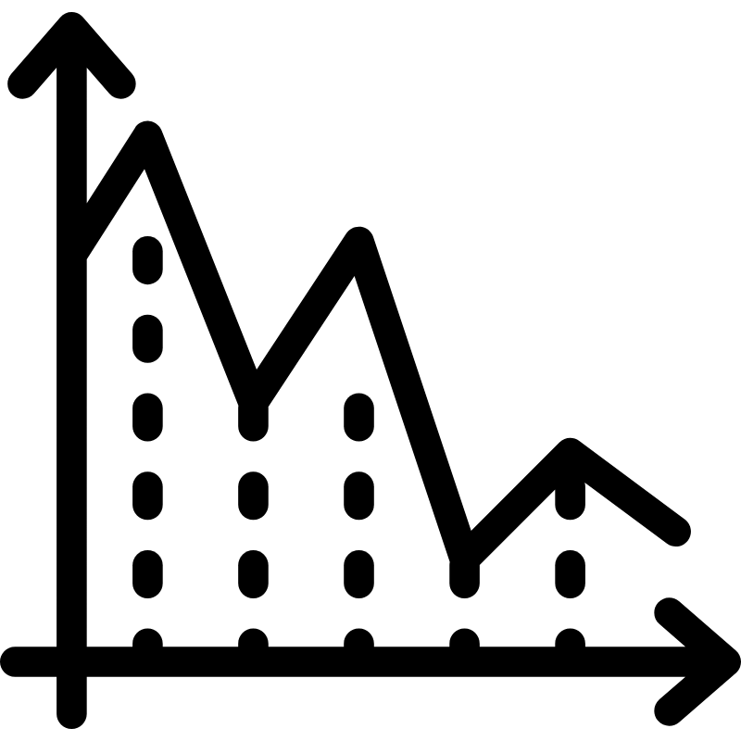
Methodology
Baseline Model
Convolutional Neural Network (CNN)
Performance Metrics
Model Settings
ROC-AUC
Accuracy
Precision
Recall
F1 Score
25 Epochs
Adam Optimizer
Cross-entropy Loss
70/20/10 Set Splits
No Resampling
17
17

Slide 18
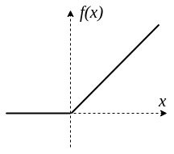
Baseline Model
Drop out
Max Pool
Batch Norm
ReLu Activation Function
Input layer
Convolutional (filter) layer
Trained multiple times
Fully connected layers (neurons)
Output
18

Slide 19
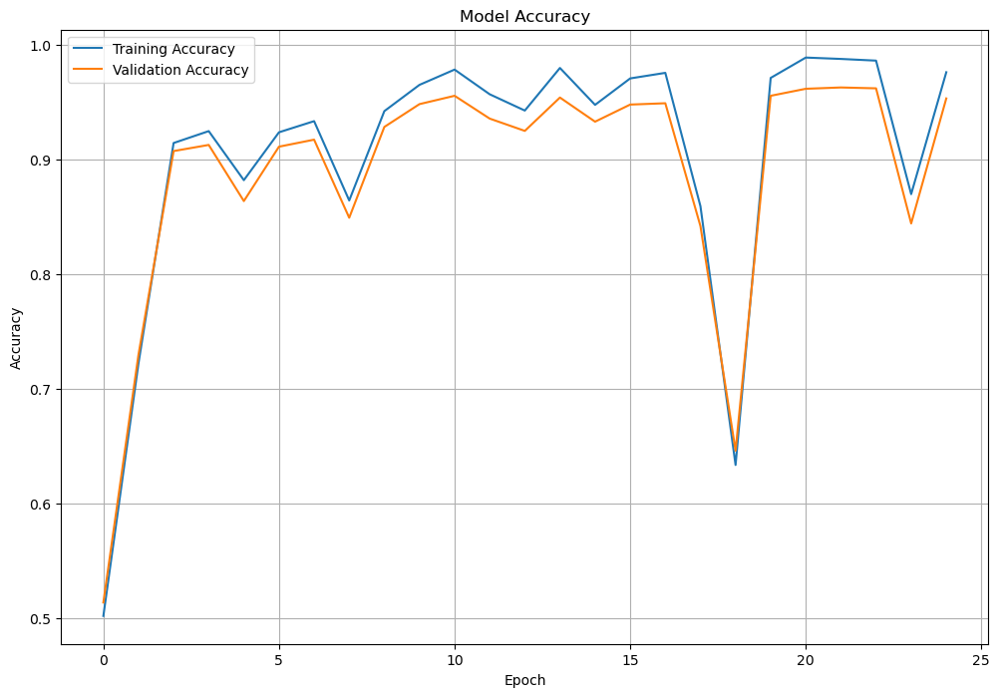
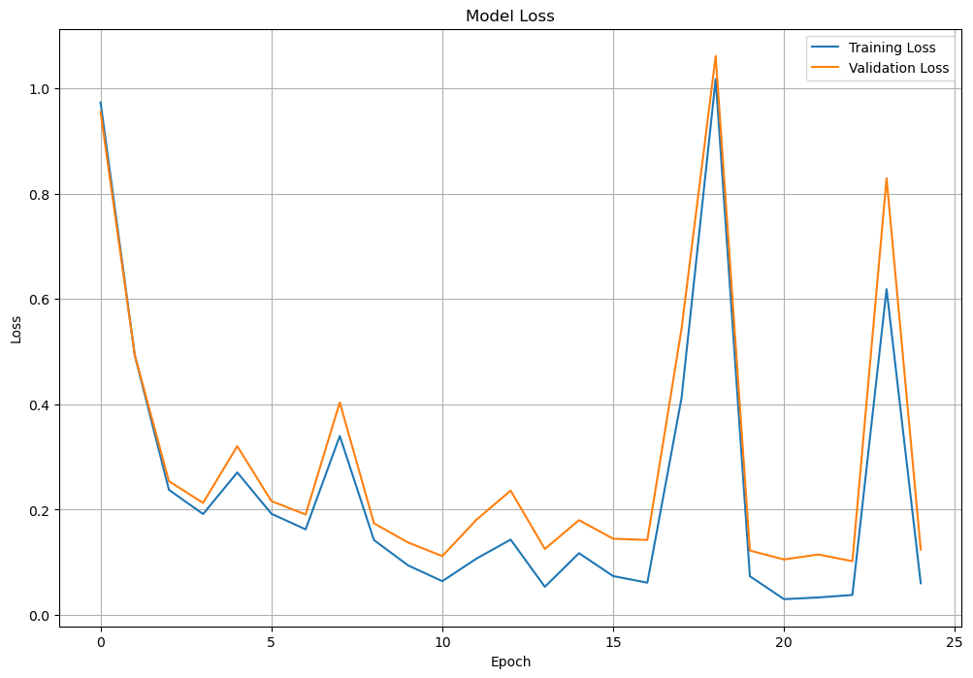
Baseline Model
Model Accuracy
Model Loss
Set | Epochs | Loss | Accuracy | Precision | Recall | F1 Score | ROC-AUC
Training | 25 | 0.0610 | 0.9977 | 0.9966 | 0.9987 | 0.9976 | 0.9997
Validation |  | 0.0862 | 0.9885 | 0.9864 | 0.9909 | 0.9886 | 0.9970

Slide 20
Transfer Learning
Overview
Choose backbone
Warm-up /
Freezing Stage
Fine-tuning / Unfreezing Stage
1
Resnet 18
5 epoch
20 epoch
2
DenseNet
3
ConvNeXt

Slide 21
1
Choose backbone
Resnet 18
Also a CNN but with shortcuts!
Resnet?
Train faster
Avoid losing information
Prevent vanishing gradients
Residual blocks can ‘remember’ the original input which is the skip path
Residual block 1
Residual block 2
Residual block 3
…. and a lot more layers
Input layer
Convolutional (filter) layer 1
Max Pool 1
Convolutional (filter) layer 2
Max Pool 2
ResNet skips here by replacing a Residual block!

Slide 22
2
Choose backbone
Features reuse
Reduces parameter usage
Combats gradient vanishing
DenseNet 121
……
many layers more
Input layer
Convolutional layer 1
Pooling layer 1
Convolutional layer 2
Pooling layer 2
Each layer receives only the immediate previous layer's output
Early feature lost or diluted through pooling and transformation

Slide 23
2
Choose backbone
DenseNet 121
output feature maps from each preceding layer are concatenated and passed as input to the next layer
DenseBlock 1
DenseBlock 2
DenseBlock 3
DenseBlock 4
DenseBlock 5

Slide 24
3
Choose backbone
ConvNeXt - base
Modern CNN that combines Vision Transformers (ViT) with CNN
Derived from ResNet50 but refined to match ViT architecture
Hybrid model which is extremely strong
Down Sample
Larger Kernel
Layer Normalization
Layer Scaling
GeLU activation
ConvNeXt block 1
ConvNeXt block 2
ConvNeXt block 3
…. and a lot more layers
Input layer
Convolutional layer 1
Pooling layer 1
Convolutional layer 2
Pooling layer 2

Slide 25


Warm-up/Freezing Stage
Fine-tuning/Unfreezing Stage
It just means training the head data set and freeze/don’t train the backbone/remaining dataset
It just means to train all the remaining dataset
(20 epoch for our case)
Why?
Why?
So pretrained model can adapt to Malaria dataset quickly!
Train model with a smaller learning rate to refine features for Malaria Detection!

Slide 26
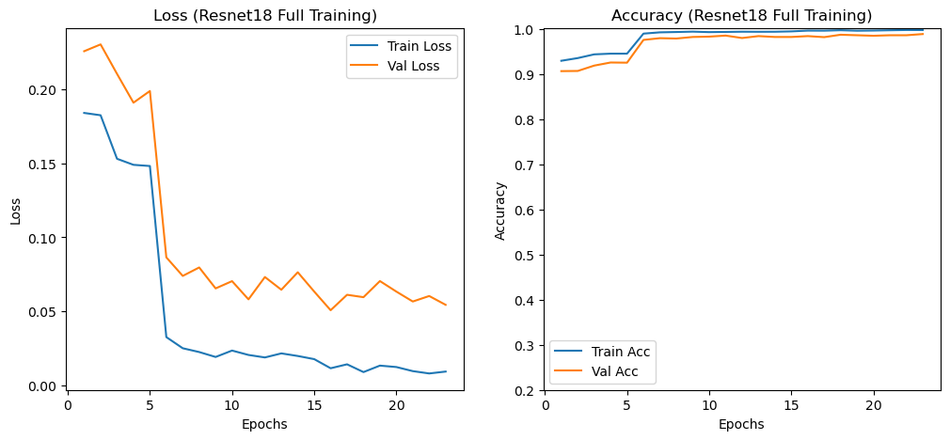
After unfreezing (epoch 6-25),
loss decreased drastically & accuracy approaches 1
Freezing Stage
Unfreezing Stage

Slide 27

Modifying Training Backbone
Recall….
Fluctuations and Spikes!

Slide 28
Modifying Training Backbone
Overview
Gradient Clipping
Label smoothing
Cosine Annealing Learning Rate Scheduler

Slide 29
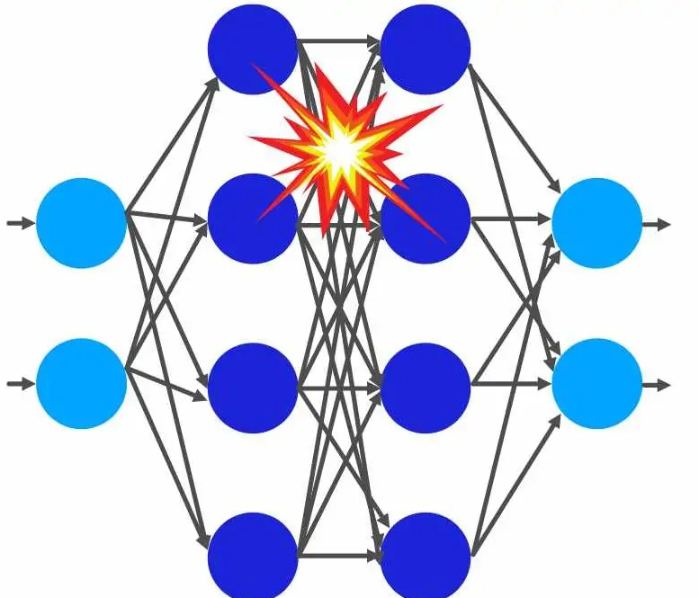
Gradient Clipping
Gradient Exploding issue:
gradient is extensively large during backpropagation

Slide 30
Gradient Clipping
restricted the L2 norm of gradients to a maximum threshold of 1.0
Without gradient clipping
With gradient clipping

Slide 31
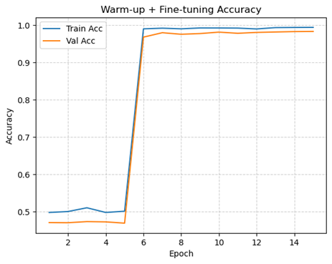
Gradient Clipping
avoided large oscillations in parameter updates and successfully maintained a consistent accuracy convergence

Slide 32
Label smoothing
Regularization technique: softens hard, one-hot labels by distributing a small portion of the probability mass to other classes
preventing overconfidence in predictions and improving model generalization

Slide 33
Cosine Annealing Learning Rate Scheduler
employed the cosine annealing for a periodic shift of learning rate following a cosine curve.
High learning rate during early training for broad exploration
Low learning rate occasionally and during latter epochs training for fine tuning

Slide 34
Results
5
Evaluation of the Model Performance on the Validation and Testing Sets

Slide 35
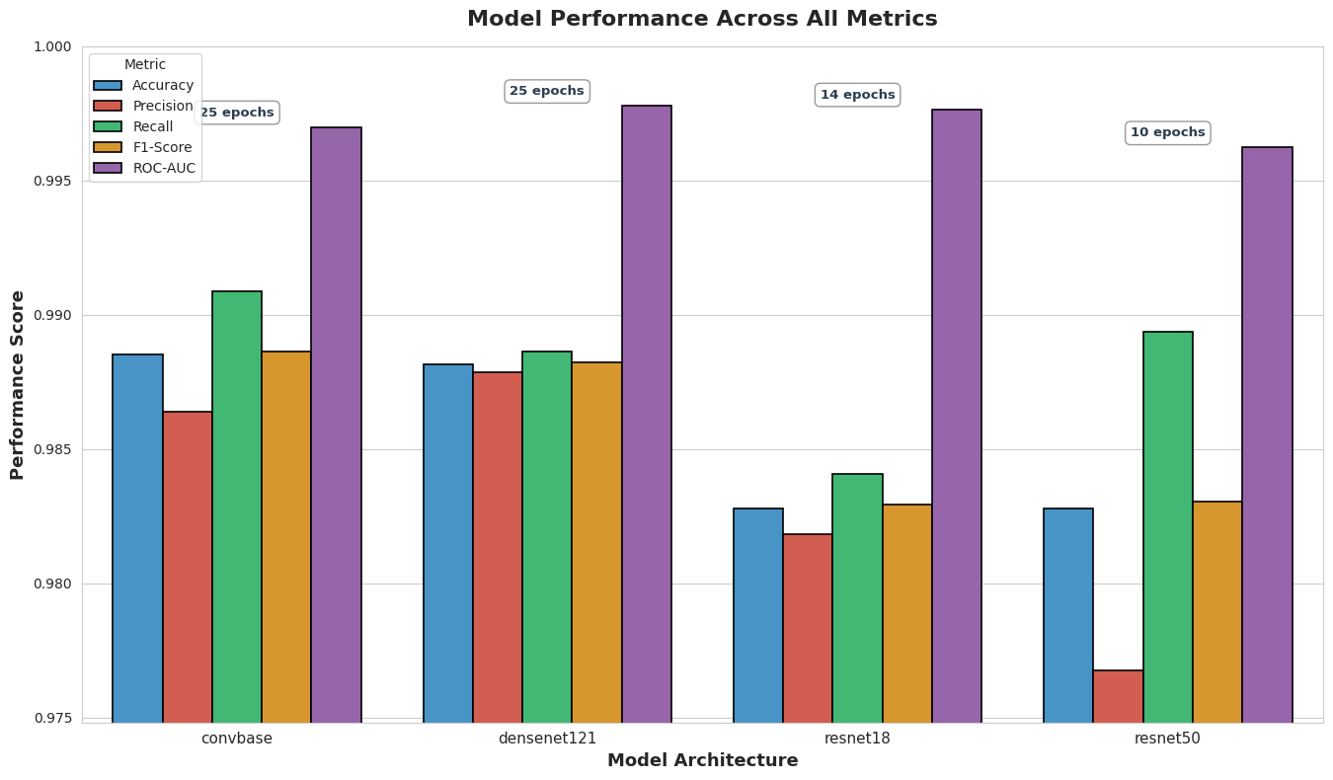
Results
Model Performance on Validation Set
Overall Performance
All models perform excellently (>97% across all metrics)
ROC-AUC highest metric
Consistent ROC-AUC performance indicates excellent class separation
ResNet50
Trades precision for recall
Fastest convergence
Best Overall
Highest Recall
DenseNet121
ConvNeXt-base

Slide 36
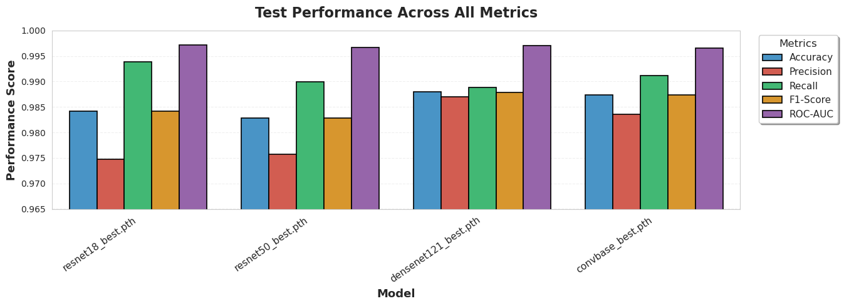
Results
Model Performance on Testing Set
Overall Performance
Strong generalization to test data (>96% across all metrics)
Precision – recall trade off
Consistent ROC-AUC performance
ROC-AUC highest metric
Best Overall
Highest Recall
DenseNet 121
ResNet 18

Slide 37



Discussion
Dataset Characteristics
Clinical Complications
Binary classification with high visual contrast
Clear parasitic markers in infected cells
Consistently high accuracy across models
High recall essential to minimize missed infections
Recommended: ResNet18 + DenseNet121
Model Performance
Minimal variance (<2%) between models
DenseNet121: Most balanced performer across metrics
ResNet18: Best test recall (99.38%) - optimal for clinical use

Slide 38
Conclusions
6
and Suggestions for the Future

Slide 39
Conclusion and Future Steps
Reviewing objectives,
1
Train deep learning model to distinguish between parasitized vs. uninfected cells
Develop a High-Accuracy Binary Classifier
2
Optimize Diagnostic Performance
Maximize recall for infected cells &
Achieve strong AUC-ROC metrics to ensure both cell classes are identified accurately

Slide 40
Conclusion and Future Steps
Overall Performance
Recommended Model
All models perform well on the training and testing set
In clinical settings, ResNet18 is best as recall is priority
Future Suggestions
Adapt
Adapt the models on real-world microscopy images captured from clinics to assess the robustness of models.
Extend
Extend the usability of the models in real world context by applying knowledge distillation
Expand
Expand the models to incorporate with different stages of malaria to detect malaria at early stages

Slide 41
Thank you!
Terima Kasih!
Umgoi! Dohje! Gamxia!
धन्यवाद! நன்றி! 谢谢！
بہت شکریہ

